Slide 1
City of Rockford Finance Task Force Home Rule

Slide 2
Home Rule Overview
Powers outlined in the 1970 Illinois Constitution
Municipalities are automatically given home rule status when population reaches 25,000
Home rule can be implemented for communities under 25,000 via referendum
Home rule can be rescinded through referendum
Rockford is one of four municipalities with home rule rescinded (Lisle, Villa Park, Lombard)
Referendum can be placed on the ballot through Council action or petition signed by 10% of the last ballots cast in a general election

Slide 3
Home Rule Powers
According to the State constitution “a home rule unit may exercise any power and perform any function pertaining to its government and affairs including, but not limited to, the power to regulate for the protection of the public health, safety, morals and welfare; to license; to tax; and to incur debt”
Powers have been broadly interpreted by the courts.
Restrictions defined in State law include:
To incur debt payable from ad valorem property tax receipts maturing more than 40 years from the time it is incurred
To define and provide for the punishment of a felony
To have an income or occupation tax
To license for revenue

Slide 4
Home Rule Legislative Changes
Limitation of utility taxes to 5% (same as non-home rule communities)
Referendum approval of real estate transfer tax
Immunity from anti-trust prosecution
Protection from having to rebate tax revenues received from home rule taxes later ruled unconstitutional

Slide 5
Local Home Rule Limitations
Downers Grove adopted policy requiring public notification of any pending board action which would constitute a power not available to non-home rule communities, including notice period and public comment
Oakbrook Terrace adopted a tax cap ordinance mirroring the state PTELL (tax cap) law

Slide 6
General Home Rule Powers
Borrowing: the ability to issue general obligation bonds without referendum and issuing revenue bonds for creative purposes (economic development, residential mortgage)
Levy: no rate limitations, can raise and lower rates to tailor levy rate categories to fit community needs
Economic Development: borrowing, imposition of development fees for future infrastructure needs, revise land use, zoning regulations, home rule sales tax rebates

Slide 7
General Home Rule Powers
Government Structure: to adopt, alter or repeal a form of government (upon approval of referendum) including increasing or decreasing size of Council, nonpartisan elections, abolishment of Board of Fire & Police Commissioners
Avoidance of state mandates: unless specifically outlined in the state law creating the mandate, the municipality can negate the law (curfew, for example)
Licensing/Regulation: ability to creatively address problems, examples include regulation of private wells, noise control, regulation of landlord-tenant relations, regulate mobile home park operators

Slide 8
Home Rule Taxing Powers
Variety of taxes commonly imposed by home rule communities, with rates unrestricted by State law, include: parking, mobile home, gasoline, new motor vehicle, sales tax
Sales tax: applies to general merchandise, not titled items or food/drugs/medical appliances; imposed in 0.25% increments and collected by the IL Department of Revenue
Hotel/motel tax: the City’s tax imposed prior to the elimination of home rule must be used for tourism and economic development; a home rule HMT could be used for general purposes
Real estate transfer tax: existing rates range between $0.50-$10 per $1,000 of property transferred

Slide 9
Home Rule Taxing Powers
Food/beverage tax: similar to HMT, can be imposed without restriction on its use
Property Tax: home rule communities are not subject to PTELL (tax caps) and rate limits, rate limits have been a growing problem for the City
Gasoline Tax: municipalities can impose a rate/gallon tax, collected by IL Dept of Revenue
Use Tax: tax on purchase of new or used cars, boats or other vehicles, to be collected by the municipality
Charges for Services:

Slide 10
Rockford Home Rule Impact

Slide 11
Comparative Community Information

Slide 12
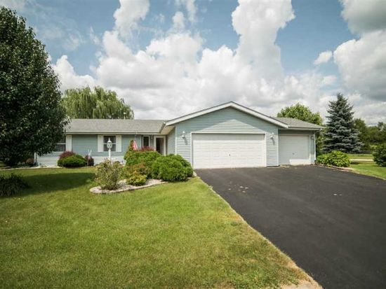
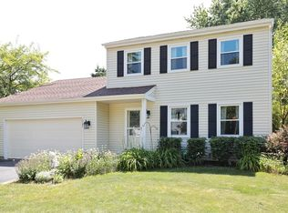
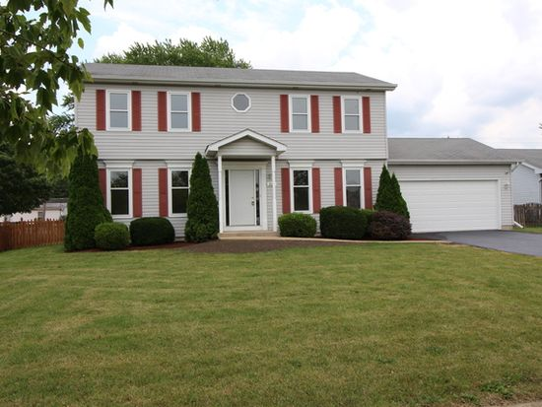
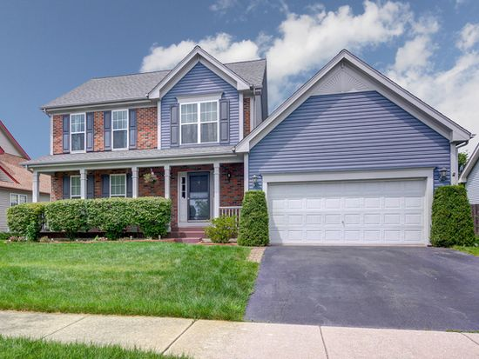
Home & Tax Bill Compare 3 bedroom, 3 bathroom, approx. 1,800 square feet
Rockford: $140,000, tax bill $4,067, city portion $883
Naperville: $335,000, tax bill $6,343, city portion $619
Joliet: $216,500, tax bill $5,163, city portion $810
Aurora: $274,950, tax bill $7,978, city portion $1,484

